Slide 1
Help Wanted Online A real-time measure of job postings
January 2021
Office of Research Connecticut Department of Labor
Connecticut Department of Labor – Research Office 200 Folly Brook Blvd. Wethersfield, CT 06109
Help Wanted Online

Slide 2
What is HWOL?
The Conference Board Help Wanted Online® Data Series (HWOL) measures the number of new, first-time Online job postings and jobs reposted from the previous month for over 50,000 Internet job boards, corporate boards and smaller job sites that serve niche markets and smaller geographic areas.
Connecticut Department of Labor – Research Office 200 Folly Brook Blvd. Wethersfield, CT 06109
Help Wanted Online

Slide 3
Upcoming Release Dates
Monthly Report: Wednesday, February 24, 2021 Wednesday, March 24, 2021 Wednesday, April 23, 2021 Weekly New Ads Report: Updated every Friday
Connecticut Department of Labor – Research Office 200 Folly Brook Blvd. Wethersfield, CT 06109
Help Wanted Online

Slide 4
Covid-19 and HWOL
In recent months, the pandemic Coronavirus (Covid-19) has caused significant social and economic implications throughout the world. This monthly HWOL report includes additional info to illustrate how Covid-19 has impacted Connecticut in the short term and highlights recent job postings in the weeks since the virus disrupted both the economy and labor markets.
Connecticut Department of Labor – Research Office 200 Folly Brook Blvd. Wethersfield, CT 06109
Help Wanted Online

Slide 5
Statewide Weekly New Job Ads
Weekly New job postings were 4,613 during the week ending 1/16/21.
Connecticut Department of Labor – Research Office 200 Folly Brook Blvd. Wethersfield, CT 06109
Help Wanted Online

Slide 6
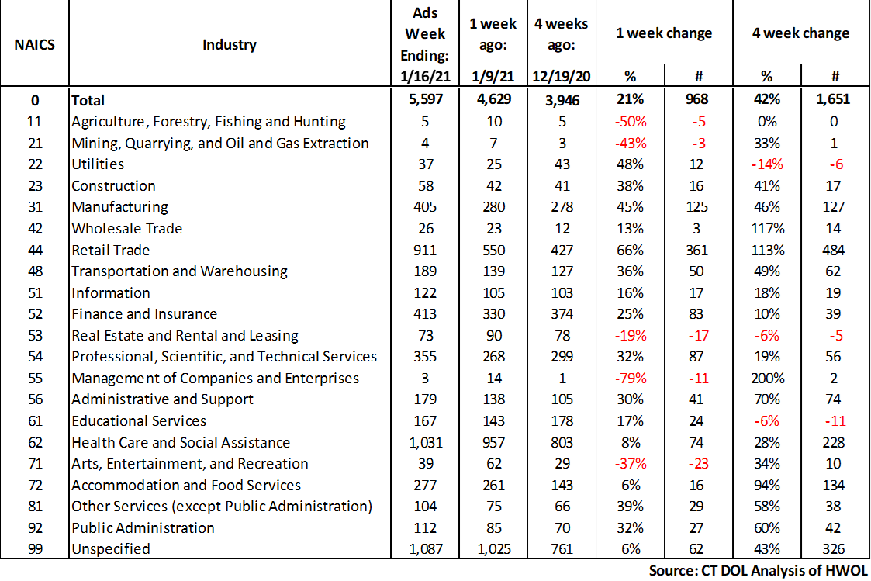
HWOL New Weekly Industry Job Ads – CT Statewide
Connecticut Department of Labor – Research Office 200 Folly Brook Blvd. Wethersfield, CT 06109
Help Wanted Online

Slide 7
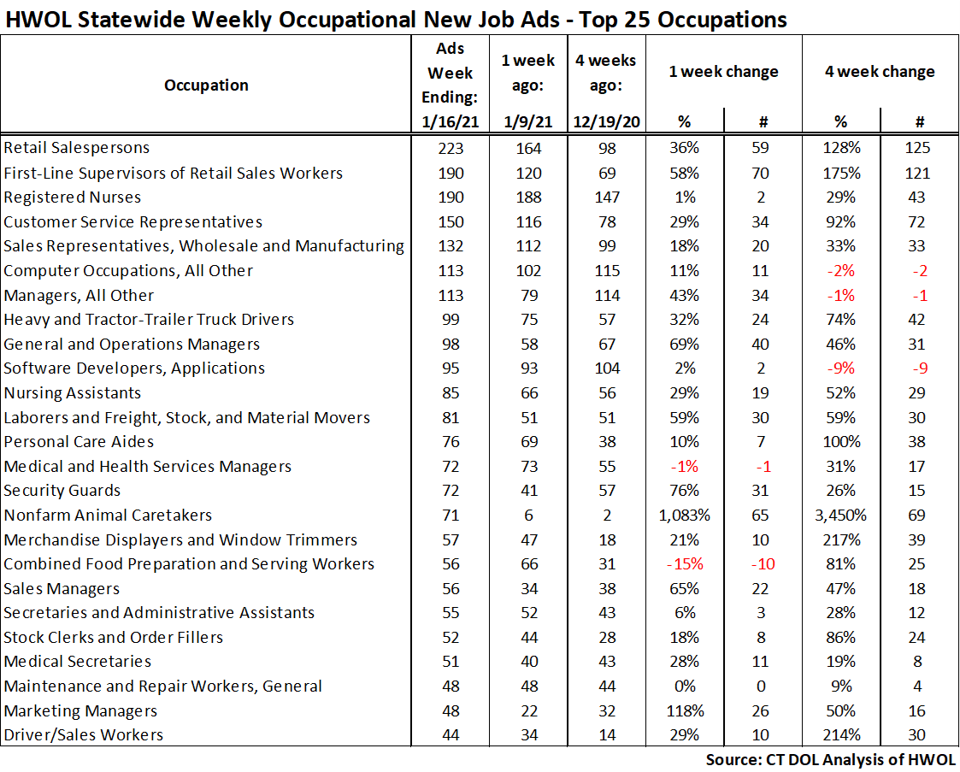
Connecticut Department of Labor – Research Office 200 Folly Brook Blvd. Wethersfield, CT 06109
Help Wanted Online

Slide 8
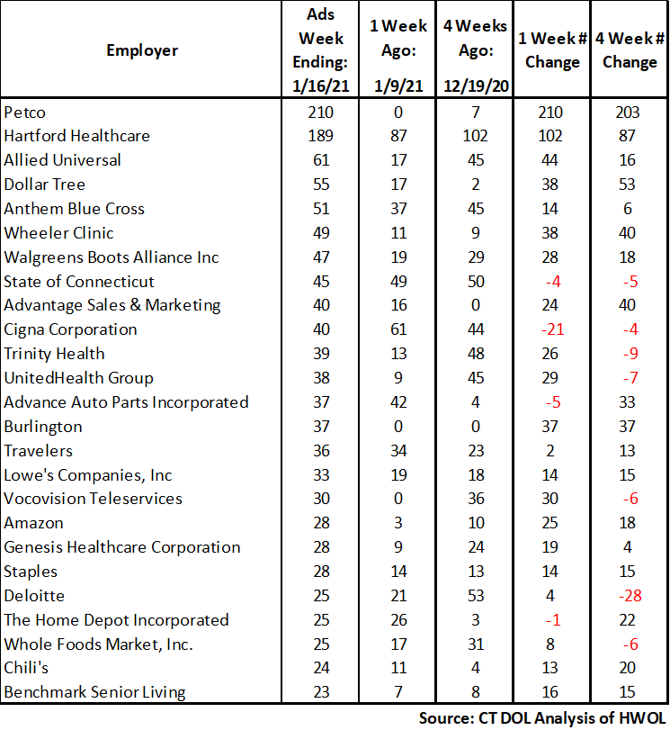
Employers with the Most New Job Postings
Connecticut Department of Labor – Research Office 200 Folly Brook Blvd. Wethersfield, CT 06109
Help Wanted Online

Slide 9
Monthly HWOL Information
The following pages contain HWOL monthly data for December 2020. This includes job posting from when Covid-19 shutdowns impacted many sectors of the Connecticut labor market. Monthly and weekly job ad information can be found here: https://www1.ctdol.state.ct.us/lmi/HWOL.asp
Connecticut Department of Labor – Research Office 200 Folly Brook Blvd. Wethersfield, CT 06109
Help Wanted Online

Slide 10
Statewide Highlights
- Total postings in Connecticut was 48,315 in December 2020. -Industry sectors with the most job postings were Health Care and Social Assistance (9,710 postings), Retail Trade (6,610 postings), Finance and Insurance (4,151 posting), Manufacturing (3,379 postings), and Professional, Scientific, and Technical Services (3,197 postings).
Occupations with the most postings were Registered Nurses (1,888 postings), Retail Sales (1,885 postings), Supervisors of Retail Sales Workers (1,257 postings) Sales Representatives, Wholesale and Manufacturing (1,226 postings) and Computer Occupations, All Others (1,221 postings).
Connecticut Department of Labor – Research Office 200 Folly Brook Blvd. Wethersfield, CT 06109
Help Wanted Online

Slide 11
Connecticut Job Ads by Educational Requirements
Connecticut Department of Labor – Research Office 200 Folly Brook Blvd. Wethersfield, CT 06109
Help Wanted Online

Slide 12
Top Certifications in Connecticut Job Ads
Connecticut Department of Labor – Research Office 200 Folly Brook Blvd. Wethersfield, CT 06109
Help Wanted Online

Slide 13
Top Skills in Connecticut Job Ads
Connecticut Department of Labor – Research Office 200 Folly Brook Blvd. Wethersfield, CT 06109
Help Wanted Online

Slide 14
Top Skills by Industry in Connecticut Job Ads
Connecticut Department of Labor – Research Office 200 Folly Brook Blvd. Wethersfield, CT 06109
Help Wanted Online

Slide 15
Top Skills by Industry in Connecticut Job Ads (Continued)
Connecticut Department of Labor – Research Office 200 Folly Brook Blvd. Wethersfield, CT 06109
Help Wanted Online

Slide 16
Connecticut Department of Labor – Research Office 200 Folly Brook Blvd. Wethersfield, CT 06109
Help Wanted Online

Slide 17
Connecticut Employers with the Most Job Ads
Connecticut Department of Labor – Research Office 200 Folly Brook Blvd. Wethersfield, CT 06109
Help Wanted Online

Slide 18
Connecticut Occupations with the Most Job Ads
Connecticut Department of Labor – Research Office 200 Folly Brook Blvd. Wethersfield, CT 06109
Help Wanted Online

Slide 19
Labor Market Area Data
Labor Market Area Highlights
Job Ads by Industry
Job Ads by Location
Employers With The Most Job Ads
Occupations With The Most Job Ads
Connecticut Department of Labor – Research Office 200 Folly Brook Blvd. Wethersfield, CT 06109
Help Wanted Online

Slide 20
Labor Market Area Highlights
Connecticut Department of Labor – Research Office 200 Folly Brook Blvd. Wethersfield, CT 06109
Help Wanted Online

Slide 21
Connecticut Department of Labor – Research Office 200 Folly Brook Blvd. Wethersfield, CT 06109
Help Wanted Online

Slide 22
Hartford LMA Job Ads by Location
Connecticut Department of Labor – Research Office 200 Folly Brook Blvd. Wethersfield, CT 06109
Help Wanted Online

Slide 23
Hartford LMA Employers
with the Most Job Ads
Cigna Corporation
State of Connecticut
UnitedHealth Group
Trinity Health
Travelers
The Hartford Financial Group
Raytheon
ICF Consulting Group Incorporated
Boston Market
Accenture
Deloitte
Wheeler Clinic
Eversource Energy
Whole Foods Market, Inc.
Guidehouse
Connecticut Institute For Blind
Dattco Travel
Advance Auto Parts Incorporated
Otis Elevator Company
CVS Health
Hartford Healthcare
Ernst & Young
Mercy Medical Center Clinton
The Home Depot Incorporated
University of Connecticut
Lowe's Companies, Inc
Eastern Connecticut Health Network
United Parcel Service Incorporated
EverSource
Allied Universal
Hospital For Special Care
Stanley Black & Decker
Pearson
Fiserv
Walgreens Boots Alliance Inc
Petco
U.S. Bancorp
BJ's Wholesale Club, Inc.
Connecticut Department of Labor – Research Office 200 Folly Brook Blvd. Wethersfield, CT 06109
Help Wanted Online

Slide 24
Hartford LMA Occupations
with the Most Job Ads
Connecticut Department of Labor – Research Office 200 Folly Brook Blvd. Wethersfield, CT 06109
Help Wanted Online

Slide 25
Connecticut Department of Labor – Research Office 200 Folly Brook Blvd. Wethersfield, CT 06109
Help Wanted Online
25

Slide 26
Bridgeport Stamford LMA Job Ads by Location
Connecticut Department of Labor – Research Office 200 Folly Brook Blvd. Wethersfield, CT 06109
Help Wanted Online

Slide 27
Bridgeport Stamford LMA Employers
with the Most Job Ads
Deloitte
Stamford Hospital
CVS Health
Whole Foods Market, Inc.
Asml
Boston Market
United Parcel Service Incorporated
Griffin Health
Lowe's Companies, Inc
Gartner Incorporated
Allied Universal
Norwalk Public School District
Amazon
Henkel
Apple Inc.
NBC
Gartner
Gartner Group
Walgreens Boots Alliance Inc
Humana
Lockheed Martin Corporation
Boehringer Ingelheim
The Home Depot Incorporated
Hartford Healthcare
Spectrum
Intuit
Charter Communications
Yale-New Haven Health System
People's United Bank
Synchrony
State of Connecticut
Sacred Heart University
UnitedHealth Group
Thermo Fisher Scientific Inc
Macy's
Rolls Royce Plc
Petco
Nordstrom
Connecticut Department of Labor – Research Office 200 Folly Brook Blvd. Wethersfield, CT 06109
Help Wanted Online

Slide 28
Bridgeport Stamford LMA Occupations
with the Most Job Ads
Connecticut Department of Labor – Research Office 200 Folly Brook Blvd. Wethersfield, CT 06109
Help Wanted Online

Slide 29
Connecticut Department of Labor – Research Office 200 Folly Brook Blvd. Wethersfield, CT 06109
Help Wanted Online

Slide 30
New Haven LMA Job Ads by Location
Connecticut Department of Labor – Research Office 200 Folly Brook Blvd. Wethersfield, CT 06109
Help Wanted Online

Slide 31
New Haven LMA Employers
with the Most Job Ads
Anthem Blue Cross
Yale University
The Home Depot Incorporated
Hartford Healthcare
Burns & McDonnell
Walgreens Boots Alliance Inc
Gaylord Specialty Healthcare
Quest Diagnostics Incorporated
State of Connecticut
Nomad Health
University of New Haven
UnitedHealth Group
Department of Veterans Affairs
Petco
Fair Haven Community Health Care
BJ's Wholesale Club, Inc.
Compass Group North America
Quinnipiac University
Medtronic
Yale-New Haven Health System
CVS Health
Amazon
Genesis Healthcare Corporation
Lowe's Companies, Inc
Masonicare Corporation
United Parcel Service Incorporated
Alexion Pharmaceuticals
Boston Market
Advance Auto Parts Incorporated
Allied Universal
Vna Community Healthcare
Avangrid, Inc
Intuit
Sanofi Aventis
H&R Block
FedEx
Southern Connecticut State University
O'Reilly Automotive Inc
Connecticut Department of Labor – Research Office 200 Folly Brook Blvd. Wethersfield, CT 06109
Help Wanted Online

Slide 32
New Haven LMA Occupations
with the Most Job Ads
Connecticut Department of Labor – Research Office 200 Folly Brook Blvd. Wethersfield, CT 06109
Help Wanted Online

Slide 33
Connecticut Department of Labor – Research Office 200 Folly Brook Blvd. Wethersfield, CT 06109
Help Wanted Online

Slide 34
New London LMA Job Ads by Location
Connecticut Department of Labor – Research Office 200 Folly Brook Blvd. Wethersfield, CT 06109
Help Wanted Online

Slide 35
New London LMA Employers
with the Most Job Ads
General Dynamics
The Home Depot Incorporated
Mohegan Sun
State of Connecticut
Genesis Healthcare Corporation
Sonalysts Incorporated
Thames Valley Council For Community Action
Walgreens Boots Alliance Inc
Backus Hospital
Utilities Service
Compass Group North America
BJ's Wholesale Club, Inc.
Eurofins Scientific
William W. Backus Hospital
Community Health Center Association Of Connecticut
Masonicare Corporation
Allied Universal
Atx Learning
Pfizer
Lowe's Companies, Inc
CVS Health
Mohegan Sun, Inc
Yale-New Haven Health System
Care At Home
Groton Public Schools
Aveanna
Community Health Center, Inc.
United Parcel Service Incorporated
Aldi
Advantage Sales & Marketing
Amentum
Petco
Advance Auto Parts Incorporated
H&R Block
United States Foods
Asplundh Tree Expert
Nordson Corporation
Connecticut Department of Labor – Research Office 200 Folly Brook Blvd. Wethersfield, CT 06109
Help Wanted Online

Slide 36
New London LMA Occupations
with the Most Job Ads
Connecticut Department of Labor – Research Office 200 Folly Brook Blvd. Wethersfield, CT 06109
Help Wanted Online

Slide 37
Connecticut Department of Labor – Research Office 200 Folly Brook Blvd. Wethersfield, CT 06109
Help Wanted Online

Slide 38
Danbury LMA Job Ads by Location
Connecticut Department of Labor – Research Office 200 Folly Brook Blvd. Wethersfield, CT 06109
Help Wanted Online

Slide 39
Danbury LMA Employers
with the Most Job Ads
The Home Depot Incorporated
Western Connecticut Health Network
Lowe's Companies, Inc
Petco
Iqvia
BJ's Wholesale Club, Inc.
Entegris Incorporated
UnitedHealth Group
Apple Inc.
Intuit
Danbury Public Schools
Maplewood At Stony Hill, Llc
Advantage Sales & Marketing
Panera Bread
Community Health Center, Inc.
Olive Garden
Western Connecticut Healthcare
Regional Hospice Of Western Connecticut
Whole Foods Market, Inc.
CVS Health
Genesis Healthcare Corporation
Boston Market
Maplewood At Stony Hill Llc
Compass Group North America
United Parcel Service Incorporated
Allied Universal
Chick-fil-A
Staples
Macy's
National Vision Incorporated
Gap Inc.
Bureau of Prisons
LHC Group
Realogy Franchise Group LLC
Aldi
Vocovision Teleservices
Connecticut Department of Labor – Research Office 200 Folly Brook Blvd. Wethersfield, CT 06109
Help Wanted Online

Slide 40
Danbury LMA Occupations
with the Most Job Ads
Connecticut Department of Labor – Research Office 200 Folly Brook Blvd. Wethersfield, CT 06109
Help Wanted Online

Slide 41
Connecticut Department of Labor – Research Office 200 Folly Brook Blvd. Wethersfield, CT 06109
Help Wanted Online

Slide 42
Waterbury LMA Employers
with the Most Job Ads
Waterbury Hospital
Mercy Medical Center Clinton
Post University
Intuit
The Home Depot Incorporated
State Farm Insurance Companies
United Parcel Service Incorporated
Seasons Hospice & Palliative Care
Compass Group North America
New Incorporated
Quest Diagnostics Incorporated
Allied Universal
Community Health Center, Inc.
Girls Incorporated
Ocean State Job Lot
Advance Auto Parts Incorporated
Banfield Pet Hospital
Naugatuck Public Schools
Paraco Gas Corporation
Trinity Health
Trinity Health Of New England
CVS Health
Mercy Hospital
CDM Smith
Wheeler Clinic
Waterbury Public Schools
Genesis Healthcare Corporation
Keystone Human Services
Connecticut Renaissance
State of Connecticut
BJ's Wholesale Club, Inc.
Drew Marine Usa
Hoffman Auto Group
Refocus Eye Health
Amazon
Hartford Healthcare
Naugatuck Valley Community College
Petco
Connecticut Department of Labor – Research Office 200 Folly Brook Blvd. Wethersfield, CT 06109
Help Wanted Online

Slide 43
Waterbury LMA Job Ads by Location
Connecticut Department of Labor – Research Office 200 Folly Brook Blvd. Wethersfield, CT 06109
Help Wanted Online

Slide 44
Waterbury LMA Occupations
with the Most Job Ads
Connecticut Department of Labor – Research Office 200 Folly Brook Blvd. Wethersfield, CT 06109
Help Wanted Online

Slide 45
Connecticut Department of Labor – Research Office 200 Folly Brook Blvd. Wethersfield, CT 06109
Help Wanted Online

Slide 46
Torrington LMA Job Ads by Location
Connecticut Department of Labor – Research Office 200 Folly Brook Blvd. Wethersfield, CT 06109
Help Wanted Online

Slide 47
Torrington LMA Employers
with the Most Job Ads
Lowe's Companies, Inc
Devereux Advanced Behavioral Health
Dymax Corporation
Mayflower Inn & Spa
Alternative Employment Incorporated
Intuit
CVS Health
Walgreens Boots Alliance Inc
Crate & Barrel
Mountainside Treatment Center
Regalcare At Torrington
YMCA
The Arc Of Litchfield County, Inc
Connecticut Junior Republic
Quest Diagnostics Incorporated
State of Connecticut
The Devereux Foundation
Aldi
Community Residences Incorporated
Hartford Healthcare
Mohawk Mountain Ski Area Inc
United Parcel Service Incorporated
Charlotte Hungerford Hospital
BJ's Wholesale Club, Inc.
Becton Dickinson
Community Health Center Association Of Connecticut
Amazon
Fuelcell Energy Inc
Petco
Roehl Transport
Caleres
William W. Backus Hospital
Compass Group North America
Ocean State Job Lot
Staples
Symbria
Xtramart
Connecticut Department of Labor – Research Office 200 Folly Brook Blvd. Wethersfield, CT 06109
Help Wanted Online

Slide 48
Torrington LMA Occupations
with the Most Job Ads
Connecticut Department of Labor – Research Office 200 Folly Brook Blvd. Wethersfield, CT 06109
Help Wanted Online

Slide 49
Connecticut Department of Labor – Research Office 200 Folly Brook Blvd. Wethersfield, CT 06109
Help Wanted Online

Slide 50
Enfield LMA Job Ads by Location
Connecticut Department of Labor – Research Office 200 Folly Brook Blvd. Wethersfield, CT 06109
Help Wanted Online

Slide 51
Enfield LMA Employers
with the Most Job Ads
Raytheon
Advance Auto Parts Incorporated
State of Connecticut
The Home Depot Incorporated
CVS Health
Allied Community Services
United Parcel Service Incorporated
Chr
Pinnacle Logistics
Allied Community Services Incorporated
Petco
Enfield School District
Physicianone Urgent Care
Specialty Printing
Vinfen
Gpm Investments Llc
Aldi
Asplundh Tree Expert
Collins Aerospace
C&S Wholesale Grocers
Es3 Llc
The Lego Group
Gandara Center
FedEx
Community Health Resources
Enterprise Rent-A-Car
Massachusetts Mutual Life Insurance
Staples
Allied Universal
Reyes Holdings
Eppendorf
Safeguard Security
TJX Companies, Inc.
Walgreens Boots Alliance Inc
Serta Incorporated
Ashley Furniture
Cantina Hospitality Llc
Healthtrax Fitness Wellness
Connecticut Department of Labor – Research Office 200 Folly Brook Blvd. Wethersfield, CT 06109
Help Wanted Online

Slide 52
Enfield LMA Occupations
with the Most Job Ads
Connecticut Department of Labor – Research Office 200 Folly Brook Blvd. Wethersfield, CT 06109
Help Wanted Online

Slide 53
Connecticut Department of Labor – Research Office 200 Folly Brook Blvd. Wethersfield, CT 06109
Help Wanted Online

Slide 54
Danielson LMA Job Ads by Location
Connecticut Department of Labor – Research Office 200 Folly Brook Blvd. Wethersfield, CT 06109
Help Wanted Online

Slide 55
Danielson-Northeast LMA Employers
with the Most Job Ads
Day Kimball Healthcare
Lowe's Companies, Inc
Advance Auto Parts Incorporated
Morgan Corporation
United Parcel Service Incorporated
Asplundh Tree Expert
Generations Family Health Center
Dattco Travel
Rodriguez
Danaher Corporation
Pomfret School
United Services Incorporated
Capstone Logistics Group
Companions Homemakers Incorporated
Sterling Community School
Autism Learning Partners
Community Residences Incorporated
Mars Incorporated
Oxford Home Care
Staples
Quality Homemakers Incorporated
CVS Health
Sonoco Products Company
Utilities Service
Sonoco Works
Hampton
Compass Group North America
Hartford Healthcare
State of Connecticut
Asplundh Tree Expert Company
Citizens
Rogers Corporation
Thornfield Hall
Aveanna
Foster Company
Mattress Firm
Roehl Transport
Whitcraft Company
Connecticut Department of Labor – Research Office 200 Folly Brook Blvd. Wethersfield, CT 06109
Help Wanted Online

Slide 56
Danielson-Northeast LMA Occupations
with the Most Job Ads
Connecticut Department of Labor – Research Office 200 Folly Brook Blvd. Wethersfield, CT 06109
Help Wanted Online

Slide 57
All advertisement data used in this publication is from the Conference Board’s Help Wanted Online data series.
For more information or data requests, contact Matthew Krzyzek in the Office of Research at the Department of Labor.
(860) 263-6287
Matthew.Krzyzek@ct.gov
For more Connecticut Labor Market Information visit:
www.ctdol.state.ct.us/lmi
https://www.facebook.com/ctlmi
Twitter: @DOL_Research
Connecticut Department of Labor – Research Office 200 Folly Brook Blvd. Wethersfield, CT 06109
Help Wanted Online

